Slide 1
BITS Pilani
Prof.Aruna Malapati
Asst Professor
Department of CSIS

Slide 2
Dialogue Systems and Chatbots

Slide 4
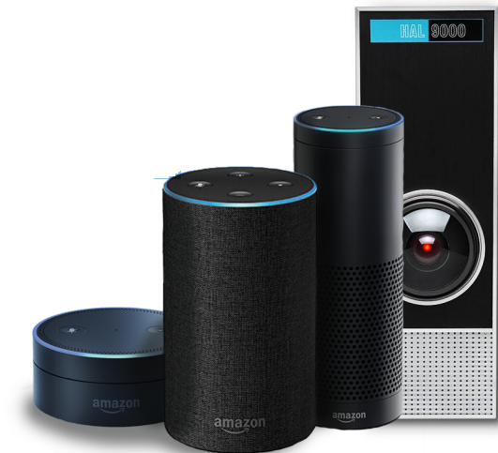
Conversational Agents aka Dialogue Systems
Digital Assistants
Answering questions on websites
Communicating with robots
Chatting for fun
Clinical uses

Slide 5
Two Classes of Dialog Systems
Task-Oriented Dialogue Agents
  Goal-Based Agents
  Siri, interface with robots, booking flights or hotels
Chatbots
  Systems designed for extended conversations
  Chatting for fun and entertainment

Slide 6
Challenging properties of human conversation
Taking turns during conversation
Speech acts
Grounding
Dialogue structure
Initiative
Implicature

Slide 7
Turn taking
A conversation is a sequence of turns, where you take a turn and then I take a turn. A turn can be a sentence, or a single word.
A system must know when to start and stop talking.
Spoken dialogue systems must also detect whether a user is done speaking, so they can process the utterance and respond. This task of endpoint detection is tricky because people often pause mid-turn.

Slide 8
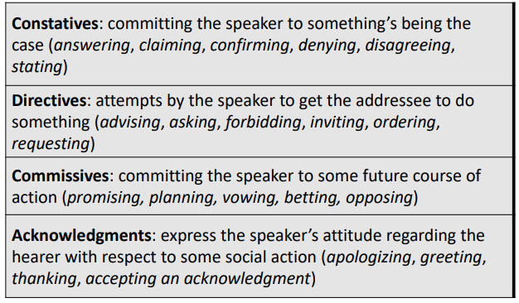
Speech acts

Slide 9
Chatbots
Systems designed for extended conversations. Chatbots mimic unstructured conversations or ‘chats’ that are characteristic of informal human-human interaction
Architecture include:
Rule-Based
  Pattern-action rules (Eliza)
Corpus-Based
  Information Retrieval
  Neural network encoder-decoder

Slide 10
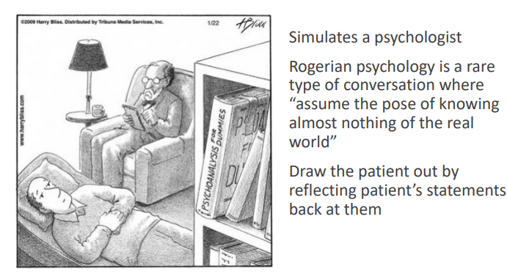
ELIZA: Weizenbaum (1966)

Slide 11
ELIZA Pattern Transform Rules
Pattern matching rules:
.* YOU (.*) ME –> WHAT MAKES YOU THINK I $1 YOU?
This rule would transform
You must really hate me into
WHAT MAKES YOU THINK I MUST REALLY HATE YOU?

Slide 12
Two Main Architectures
1. Information Retrieval
2. Machine Learned Sequence Transduction
Focus on generating a single response turn that is appropriate given the user’s immediately previous utterance or two

Slide 13
Conversational Data
Need: large collections of human conversations
Conversational threads on Twitter or Weibo
Retrieve dialog from movies, indexing subtitles
Recorded telephone conversations, collected for speech research
Crowdsourced conversations via Mechanical Turk and ParlAI

Slide 14
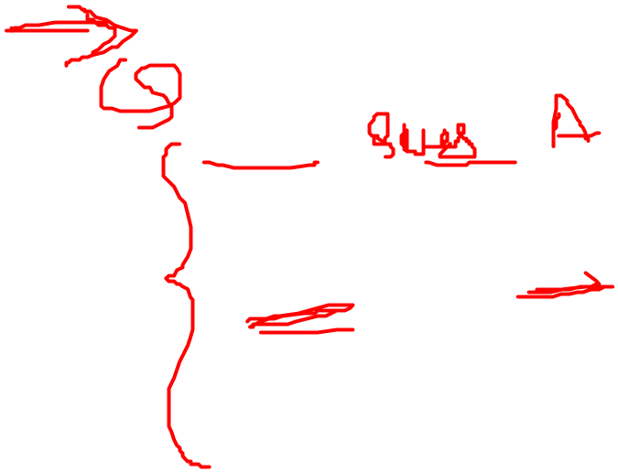
Information Retrieval based Chatbots
Treat the human user’s input as a query vector q
Search over a large corpus C of conversation to find the closest matching turn t’ in those previous conversations.
Return the response r to that conversational turn.
t’ = arg max_{t∈c} cosine_similarity(q, t).
r = response(t’)
q = Have you watched Doctor Who?
t’ = Do you like Doctor Who?
r = Yes, I love SciFi shows!

Slide 15
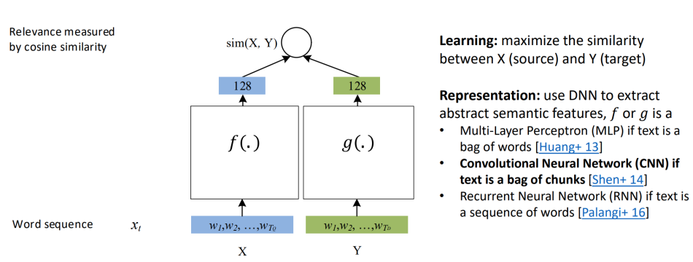

IR with Neural Network-Based Similarity Model

Slide 16
IR-based Models
Can use more features than just words in query q
  User features - Information about the user or sentiment
  Prior turns – Use conversation so far
  Narrative (non-dialogue) text
    COBOT chatbot (Isbell et al., 2000) :
    Generate responses by selecting sentences from the Unabomber Manifesto by Theodore Kaczynski, articles on alien abduction, the scripts of “The Big Lebowski” and “Planet of the Apes”
    Wikipedia Text

Slide 17
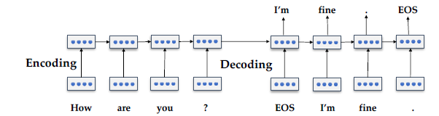

Neural Chatbots
Use an Encode and decoder to solve this problem.

Slide 18
Sequence Modelling Applications
Y’
x₀
One-One Binary Classification
Many-One Binary Classification
Sentiment classification

Slide 19
Sequence Modelling Applications (Contd..)
x
One-Many Binary Classification
Image captioning
Many-Many Binary Classification
Machine Translation

Slide 20

The Perceptron revisited
X⁽¹⁾
X⁽²⁾
Z
Y’
X⁽³⁾
X⁽¹⁾,X⁽²⁾…X^{(m)} Inputs
W₁,W₂,…W_{m} Weight Matrix
Inputs are in a single time step in the input

Slide 21
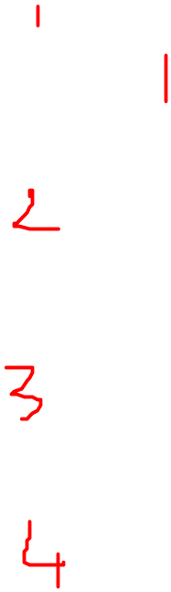
Feed Forward Neural Network
Y’⁽¹⁾
X⁽¹⁾
Y’⁽²⁾
X⁽²⁾
Y’⁽³⁾
X⁽³⁾
Y’⁽⁴⁾
X ϵ Ʀ^{m}
Y’ ϵ Ʀ^{n}

Slide 22
Feed Forward Neural Network
Xt
Y’t
X ϵ Ʀ^{m}
Y’ ϵ Ʀ^{n}

Slide 23

How to handle individual time steps?
Output Vector
Y’t
Y₀’_{t}
Y₁’_{t}
Y₂’_{t}
Y’_{3t}
Xt
X₀
X₁
X₂
X₃
Input Vector
Y’t=f(Xt)

Slide 24
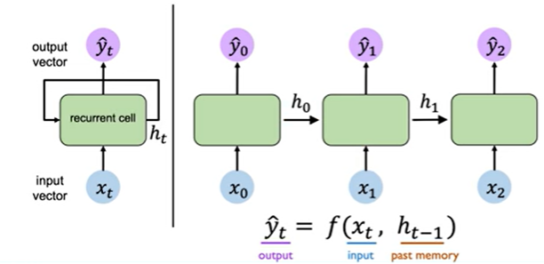
Recurrent Neural Networks (RNNs)

Slide 25
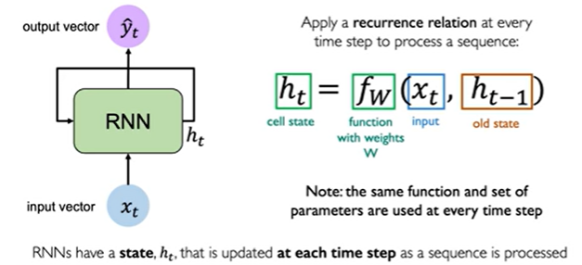
Recurrent Neural Networks (RNNs)

Slide 26
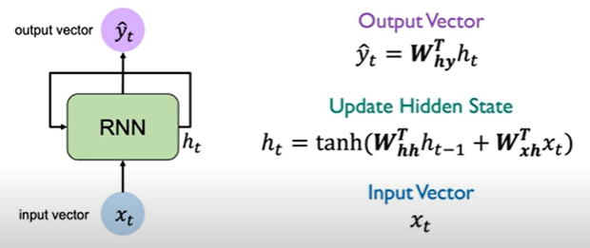

RNN Computations

Slide 27

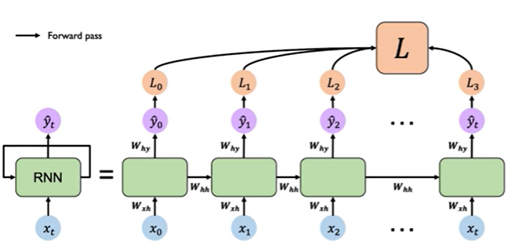
RNN computational graph

Slide 28
Sequence Modelling: Design Criteria
To model sequences, we need
Handle variable length sequences
Long terms dependencies
Maintain the order of information
Share parameters across the sequences

Slide 29
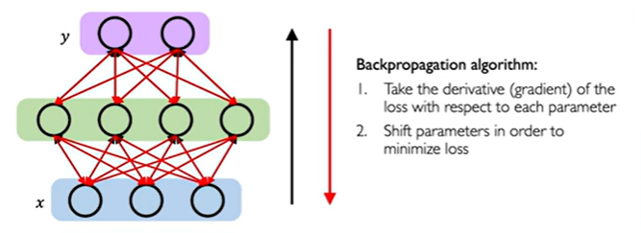
Backpropagation in time

Slide 30
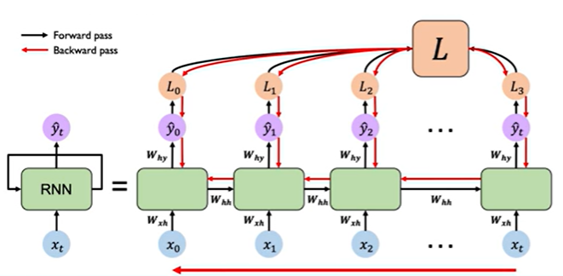
RNN Backpropagation in time

Slide 31
Standard RNN Gradient Flow
h₀
h₁
h₂
h_{t}
W_{hh}
W_{hh}
W_{hh}
W_{xh}
W_{xh}
……..
W_{xh}
W_{xh}
x₀
x₁
x₂
x_{t}
Computing the gradient wrt h₀ involves many factors of the weight matrix W_{hh} + repeated gradient computation.
Many values > 1
exploding gradients
Gradient clipping to
scale big gradients
Many values < 1
vanishing gradients
1.Activation function
2. Weights initialization
3.Network architecture
Notes:
This can be problematic for a couple of reasons. The first being that if we have many values in this series of computations this chain of matrix multiplication where the gradient values are > 1 we run into exploding gradient problem where the gradients are going to become extremely large and we cannot really optimize. The solution to this is to perform gradient clipping where we scale the values back the values particularly large gradients to try and mitigate this.
We can also have the opposite problem where now our weight values are very very small and this can lead to a vanish gradient problem. When gradients become increasing smaller and smaller and smaller such that we can no longer effectively train the network.
We address 3 ways of handling this vanish gradient problem

Slide 32
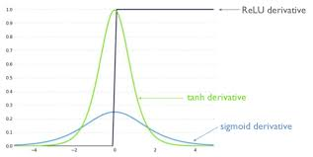
Choose the right activation function
Using ReLU prevents f’ from
shrinking the gradients when x>0

Slide 33
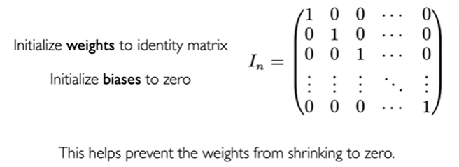
Initialize the parameters

Slide 34
Gated cells
Use more complex recurrent unit with gates to control what information is relevant.
Long Short Term Memory (LSTMs) networks rely on a gated cell to track information throughout the input time steps.
LSTMs are particularly useful to maintaining long term dependencies in the data across multiple time steps to overcome the vanishing gradient problem and model sequential data.
gated cell
LSTM,GRU

Slide 35
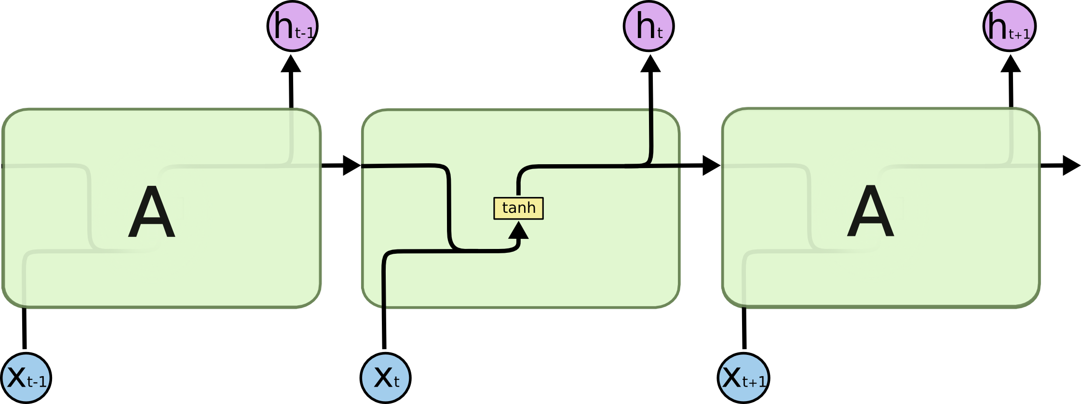
Standard RNN
A standard RNN has a repeating module containing a simple computational node.

Slide 36
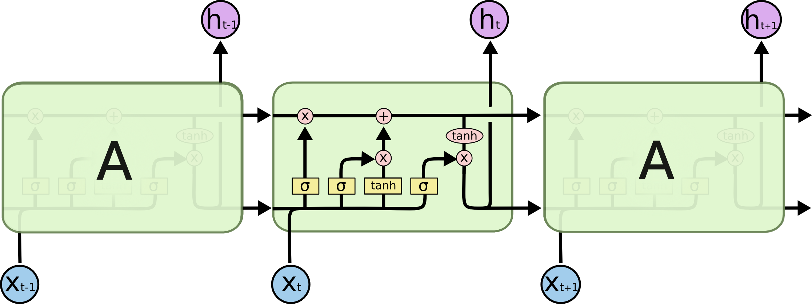
LSTMs
LSTM modules contain computational blocks that control information flow.

Slide 37
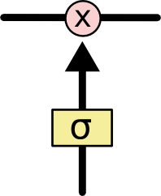
LSTMs (Contd..)
Information is added or removed through the gates.
These gates optionally let the information through, for example via a standard Neural network with sigmoid activation function.

Slide 38
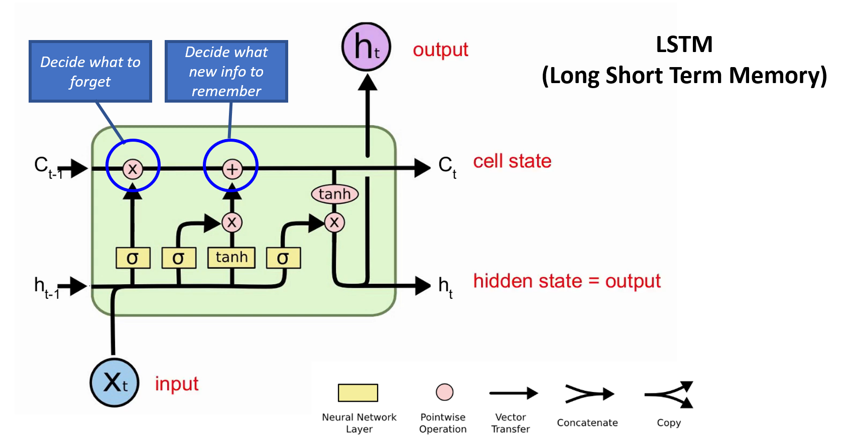
LSTMs (Contd..)
LSTMs regulate information flow vis these four steps
Forget
Store
Update
Output

Slide 39
Application of RNN for Dialogue

Slide 40
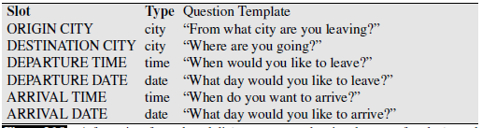
Frame based Dialogue systems
These chatbots help user solve a task like Airline reservations, hotel booking..
First proposed in GUS system in 1977.

Slide 41
Control structure for GUS frame architecture
Systems asks a set of questions to the user and based on the responses fills the slots.
I want a flight from San Francisco to Denver one way leaving after five p.m. on Tuesday.
Once all the slots are filled it performs a database query

Slide 42
GUS NLU for slot filling
Domain classification
  airlines, programming an alarm clock, or dealing with their calendar
Intent determination
  Find a Movie, or Show a Flight, or Remove slot filling a Calendar Appointment.
Slot filling
  extract the particular slots and fillers that the user intends

Slide 43
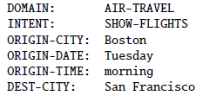

NLU for slot filling
Show me morning flights from Boston to San Francisco on Tuesday
Wake me tomorrow at 6

Slide 44
Rule based slot filling
Regular expression for recognizing the SET-ALARM intent:
wake me (up) | set (the|an) alarm | get me up

Slide 45
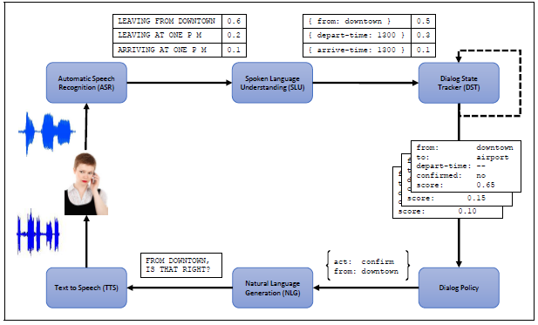
Dialogue State Architecture
Improved version of Frame based architecture.

Slide 46
Components in Dialogue State Architecture
NLU: extract slot fillers from the user’s utterance
Dialogue state tracker: maintains the current state of the dialogue
Dialogue policy: decides what the system should do or say next.
NLG: Produce natural sentences

Slide 47
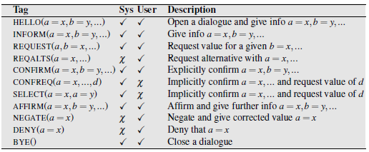
Dialogue acts

Slide 48
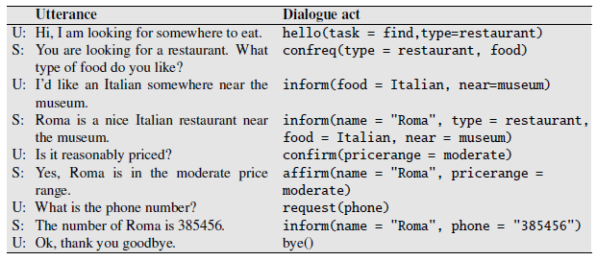
Dialogue acts (contd..)

Slide 49
Slot Filling
Build ML models to map words to semantic frames fillers.
Training data
i/p: I want to fly to San Francisco on Monday afternoon please
o/p: Destination: SF
Time: Monday

Slide 50
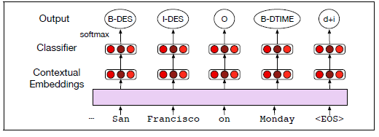
Slot filling using contextual embeddings

Slide 51
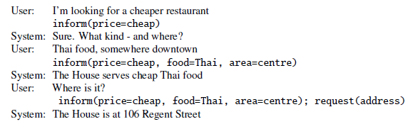
Dialogue state tracker
The task of the dialogue state tracker is to determine both the current state of the frame and the users most recent dialogue act.

